Slide 1
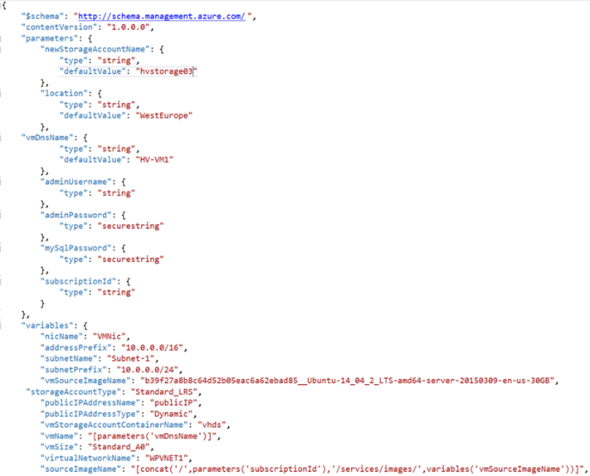
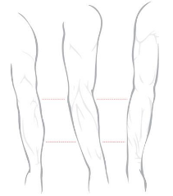


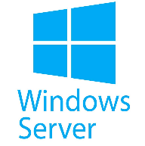

P20 Virtual Hackathon #3
Infrastructure as Code
Automation with ARM Templates
March 20th-22nd, 2018

Slide 2
Kick Off Agenda
Welcome & Intros
How all of this will work
Infrastructure as Code overview
Kick off & squad formation
HACK!!!
Notes:
Welcome to homeroom… where we take attendance and make all the announcements, say the pledge of allegiance, etc.

Slide 3

P20 Virtual Hackathon #3
Welcome & Intros
Albert Wolchesky
SME – Azure IaaS
Peter Laudati
Ali Hussain
SME – Cat Herder
SME – Azure IaaS
Notes:
Bem vinda! Bienvenidos!
Welcome to the OCP P20 Level UP! event
Olá! Meu nome é Peter Laudati
Eu sou djee Nova Jersey
Y por mis amigos de los otros paises,
Me llamo Peter. Soy de Neuva Jersey, y yo vivo circa de Neuva York.

Slide 4
Our Strategy
P20, Culture, & Mission
Attract, Retain, and Develop the Top Technical Talent in the Company.
P20 Mission
Continuous Investment and Commitment to Technical & Engagement Excellence in our careers & passions and as trusted leaders to our partners, Microsoft & the industry.

Slide 5

ARM Tempaltes
L400+
Capability Level
L300
Infra & Mgmt
L200
Modern Workplace
Business Apps
Apps & Infrastructure
Data & AI
Technology & Solution Area

Slide 6
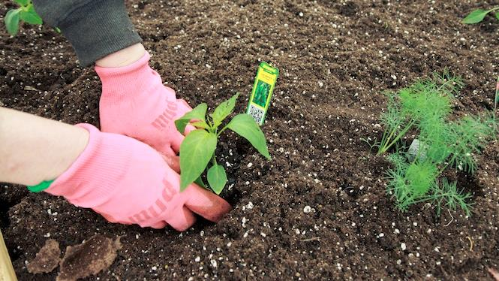
You will get your hands dirty

Slide 7
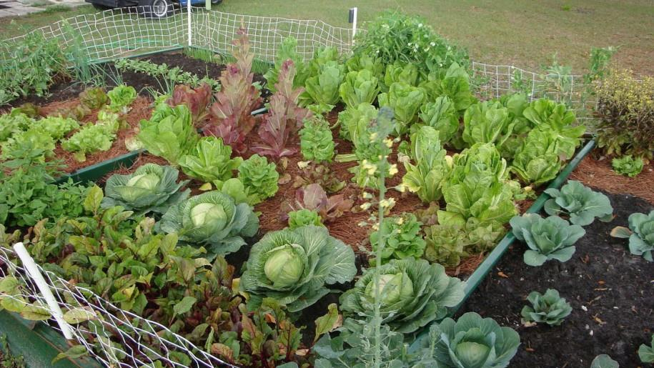
*results may vary
Notes:
You might not grow a garden like this… but at least you can learn while trying.

Slide 8


Slide 9
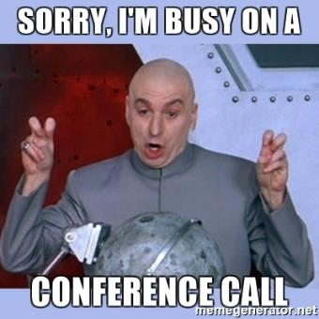

This EVENT is all about us!
Focus and Be Present
If it’s not on fire, put email & phones aside!
This is about growing OUR technical skills together
This is about working with new teammates
Make friends. Learn who knows what.
Work on your circles: Help others! Learn from others!

Slide 10

Logistics

Slide 11

Logistics Food
Notes:
Plenty of food… all of the time…
Breakfast – “Pre-function 3”
Mid-morning Snacks
Lunch – “Pre-function 3”
Afternoon Snacks
COFFEE – ALL DAY!!!
Dinner – Washington 2, 3, & 4
Dinner upstairs today and Wednesday. Thursday will be slightly different…

Slide 12
How This will Work…
Squad Formation
Technology Overview
Proctors & Challenges
Share on MS Teams
Learn with breaks along the way

Slide 13
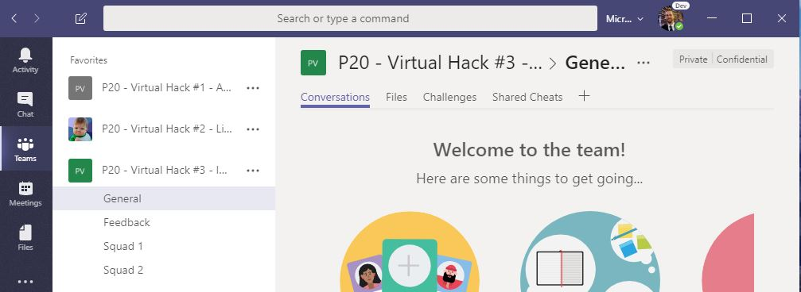
Using MS Teams
The kickoff, tech overviews, stand-ups, and wrap up will take place in the General channel
Hang out, communicate, talk, and screenshare with squad members in your squad’s channel
DURING & after the event, share feedback with the proctors in the Feedback channel. This will help them improve the event as it progresses and make the next one even better
Find any files, resources, or code samples, and THIS presentation here!
Challenges will be posted here by the proctors throughout the event
Share tips, tricks, gotchas (how you solved them), code snippets, and links you learn along the way here with everyone

Slide 14
Agenda (all 3 days)
PowerPoint Overview
Iterative hands on challenges
Breaks for food and stretching
More team challenges
Sharing & recaps throughout the day

Slide 15
IRL Hackathon Schedule
 | Tuesday 3/20 | Wednesday 3/21 | Thursday 3/22
10:00am – 11:00am | Kick-Off + IaC Overview | Morning Hack (w/breaks) | Morning Hack (w/special guest Scott Emigh)
11:00am | Morning Hack (w/breaks) |  | Morning Hack
12:00pm |  |  | Wrap Up & Feedback
1:00pm | Lunch | Lunch | Lunch & Depart
1:00pm – 5:00pm | Afternoon Hack (w/breaks) | Afternoon Hack (w/breaks) | Go home already! It’s Friday! Or keep on hacking if you like.
5:00pm – 6:00pm | Afternoon Hack (for the hardy) | Stand-up & Walk to…
6:00pm – ???? | Free time (free to plan dinner) | OCP Bees Social Event

Slide 16

Dodgeball!!!
Notes:
If in person, nominate team leaders, let them pick their own teammates.

Slide 17
What’s next?
Come with a squad name
Create a squad channel in MS Teams
Challenge #0 -> Get your workstation ready!

Slide 18
Squad Formation
Squad 1:
Squad 2:
Squad 3:

Slide 19
Technology Overview…

Slide 20



Why are we here?

Slide 21
Challenge #0 Step 1: Get your machines ready!
Install Windows Subsystem for Linux (Bash Shell)
Install the Azure CLI (V2)
Install PowerShell Cmdlets for Azure
Install Visual Studio Code
Install ARM Template plugins for VS Code
ARM Tools
ARM Snippets
Install Azure Storage Explorer
Notes:
If you have a Mac… great! You’re already a step ahead.
If not, get your Windows box loaded up with all the tools that work well in the OSS world!

Slide 22

And now death by Power Point… (for less than an hour)

Slide 23
Infrastructure as Code

Slide 24
Infrastructure as Code
It’s critical to succeeding in the cloud!

Slide 25








Infrastructure as Code Three major parts
Deploying infrastructure
All of the stuff outside the VM
Vnets, VMs, load balancers, storage, etc
Configuration Management
Configuring all of the stuff inside the VM
Security, services, software, etc.
Orchestration
Stringing it all together with automation
ARM Templates
PowerShell
DSC
Notes:
If you have a Mac… great! You’re already a step ahead.
If not, get your Windows box loaded up with all the tools that work well in the OSS world!

Slide 26
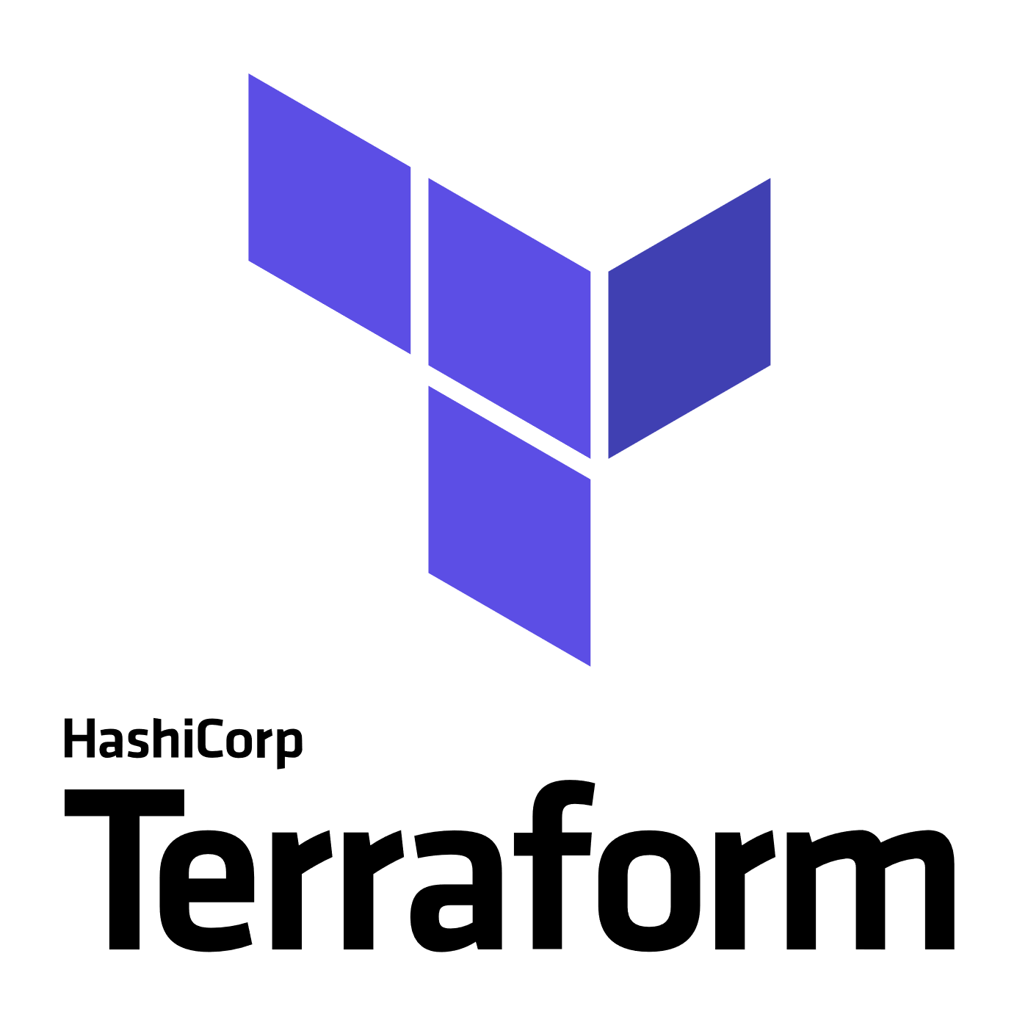
3rd Party
Infrastructure
Deployment (Orchestration)
Terraform
A popular Infrastructure as Code tool as it has support for Azure, AWS, GCP, OpenStack and bare metal, providing customers with a single provisioning language across providers
Provider modules allow for provider specific features, so no “lowest common denominator” flaws of similar multi-cloud tools
“Planning” provides users a preview of changes prior to execution (Terraform plan)
https://docs.microsoft.com/en-us/azure/virtual-machines/terraform-create-complete-vm
https://www.terraform.io/docs/providers/azurerm/
Packer
An automated image builder capable of building containers, but primarily used for automating VM image builds
A great tool when combined with DevOps pipelines that are targeting deployment to services like Azure VMs, VM Scale Sets or Batch
Used internally to deliver VM images for HD Insights and Azure Container Service
https://aka.ms/azpacker

Slide 27


3rd Party
Configuration Management & Orchestration
Ansible
Configuration Management & Orchestration
Agentless architecture over SSH / WinRM
Benefit of more easily integrating existing environments
YAML based “Playbooks” to define automation tasks as code
Project now run by Red Hat
https://docs.microsoft.com/en-us/azure/virtual-machines/linux/ansible-create-complete-vm
https://docs.ansible.com/ansible/guide_azure.html
Chef Server
Configuration Management
Integrates in to Chef’s Automate offering, available in Azure Marketplace
YAML/JSON based “Cookbooks” to define automation tasks as code
Agent based, requires an agent installed on managed servers.
https://www.chef.io/implementations/azure/
Notes:
Compare/Contrast: (Orchestration vs Configuration Management tools) Configuration management tools such as Chef and Ansible,typically default to a mutable infrastructure paradigm. For example, if you tell Chef to install a new version of OpenSSL, it’ll run the update on your existing servers and the changes will happen in-place. Over time, as you apply more and more updates, each server builds up a unique history of changes. This often can lead to configuration drift, where each server becomes slightly different than all the others, leading to subtle configuration bugs that are difficult to diagnose/reproduce. If you’re using an orchestration tool such as Terraform to deploy machine images created by Docker or Packer, then every “change” is actually a deployment of a new server, you would create a new image using Packer or Docker with the new version of OpenSSL already installed, deploy that image across a set of totally new servers, and then de-provision the old servers. This approach reduces the likelihood of configuration drift bugs. Of course, it’s possible to force configuration management tools to do immutable deployments too, but it’s not the idiomatic approach for those tools, whereas it’s a natural way to use orchestration tools.
Chef and Ansible encourage a procedural style where you write code that specifies, step-by-step, how to to achieve some desired end state. Terraform, CloudFormation, SaltStack, and Puppet all encourage a more declarative style where you write code that specifies your desired end state

Slide 28


OrchestrationTools
Jenkins
Most popular Continuous Integration & Continuous Delivery Tool
Especially popular with Java shops
An extensive community and catalog of plugins available
Azure Plugins available to use on-demand VMs for Build & Test
Jenkins Solution Template: https://aka.ms/jenkins-on-azure
Microsoft published. A Jenkins build secured for Azure and pre-configured with Azure plugins and tools
Jenkins Hub is a great starting point for customers: http://aka.ms/azjenkinshub
Spinnaker
Continuous Deployment Tool
Originally open sourced by NetFlix
Provides the ability to manage continuous deployment pipelines with multiple deployment strategies and the ability to roll back easily to previous versions
Spinnaker Code Labs for Azure:
CD to Azure VM ScaleSet
CD to K8s on Azure

Slide 29

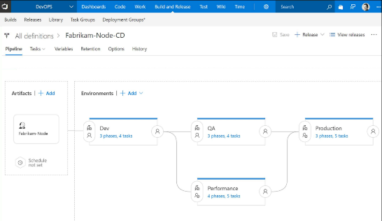
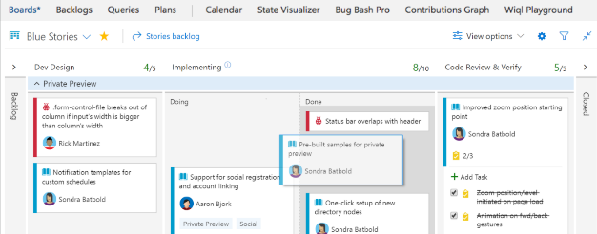
CI/CD Tools
Visual Studio Team Services
Microsoft’s Continuous Integration & Continuous Delivery Tool
Test and deploy your code to production with high-performance pipelines. Start small and scale up as needed.
VSTS has everything you love about Git with free private repositories, pull requests, and code review.
Collaborate with coworkers then integrate with CI/CD to get your code to production fast.
VSTS gives you configurable Kanban boards, interactive backlogs, simple planning tools, and out-of-the-box support for Scrum-all integrated together for traceability and reporting.
Code once and share packages across your organization. Host your private Nuget, npm, and Maven packages with VSTS for more reliable, scalable builds.
Use VSTS to setup test plans and track and report manual tests, run automated test suites, and run cloud-based load tests.

Slide 30
Azure Resource Manager Overview

Slide 31



Azure structure
Account and enterprise agreement
Subscription(s)
Resource group
Resource group
SQL
SQL
Role-based access control
Tags
Azure Resource Manager policy
Templates
Notes:
Presentation notes:
Key concepts:
Resource groups: application lifecycle boundary; container that holds resources.
Resources: web apps, Azure SQL Database, storage account, network, and so on…almost everything.
RBAC (role-based access control): User groups with role permissions assigned to resource groups.
Tags: Key value pairs assigned to resources or resource groups.
Policy: Restrictions on resources; for example, we can enforce mandatory tags per resource type.
Templates: JSON (JavaScript Object Notation) defining deployment and configuration of your application.
Slide objective:
Explain the hierarchy of the Azure model and key concepts.
Speaker notes:
When we talk about how we’ve done our Azure structure, we think about subscriptions. You want to lay out your subscriptions based on technology, the type of policy that you want to apply, and how your business is laid out. We use RBAC, which is role-based access control, to ensure that the right people have the right access to the right subscriptions. We want to make sure that people can operate their business, information remains protected, and people can’t make changes when they’re not supposed to.
The lower level is the concept of the resource group, an Azure construct that allows you to put the various resources associated with a single app into a resource group and then apply policy from Azure Resource Manager and tags. We use tags—key-value pairs—in Microsoft IT to identify the organization that it’s related to, the environment, and the app ID, a unique identifier. We can use these tags to associate different resources to a different app, organization, or environment, and then make business decisions based on that. Resources include web apps, Azure SQL Database, storage account, and so on.
Templates: We’ve created specific templates that internal teams can use to build out resources, and we ensure that they build them out according to our standards and policies. Templates enforce the creation of tags for tracking.

Slide 32
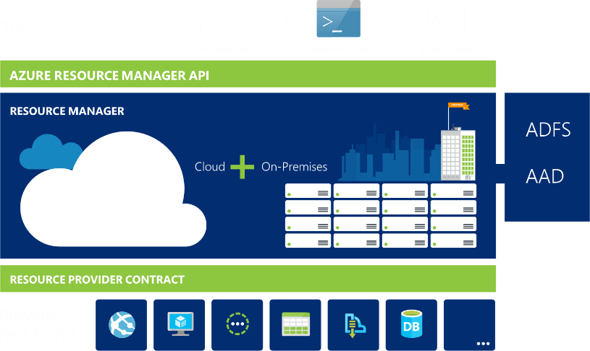
Azure Resource Manager
Azure Resource Manager or ARM management interface for Azure
Notes:
ARM is the underlying tooling that allows for the provisioning, securing and deployment of Azure Resources.

Slide 33
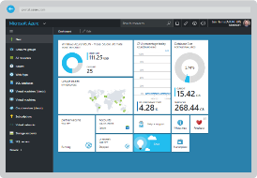
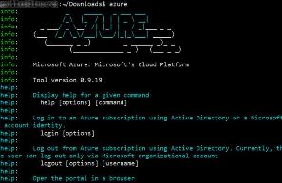
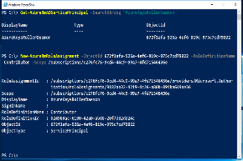

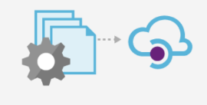
Azure Portal
Azure CLI
Azure PowerShell
Azure Resource Manager
Tenant
Tenant
Azure API
Subscription
Subscription
Subscription
Resource Group
Resource Group
Resource Group
Resource Group

Slide 34
Resource Providers
Web Site
Storage
Individual resources
Provision resources in isolation
Deployment becomes more complex
Management of app is challenging
Proper use of resources becomes more abstract
Isolation makes communication a challenge
Database
Virtual Machine

Slide 35
Resource Groups
Logical groups of multiple resources of similar or different types
Every resource must be in a resource group, cannot be in more than one
Resources inside resource group may span across regions
Resource Group has a location for storing metadata
RESOU
R
CE G
R
OUP

Slide 36
Resource Group Lifecycle
Question:
Should these resources be in the same group or a different one?
Hint:
Do they have common lifecycle and management?
Answer:
Up to you.

Slide 37
Organizational concepts
Resource groups
Tightly coupled to a container of resources
Follows RBAC rules
1 resource group at a time
Tags
Loosely coupled user or system defined categorization
Arbitrary boundaries
15 tags to use as needed
Resource groups and tags are the building blocks from which users define applications.

Slide 38
Scripting vs Declarative
PowerShell or Azure CLI
Sequential code calling commands to create the infrastructure.
ARM Templates
A JavaScript Object Notation (JSON) file that defines one or more resources to deploy to a resource group. It also defines the dependencies between the deployed resources. The template can be used to deploy the resources consistently and repeatedly.
declarative syntax - Syntax that lets you state "Here is what I intend to create" without having to write the sequence of programming commands to create it. The ARM template is an example of declarative syntax.

Slide 39
Creating a template
Visual Studio
Resource Group project type contains a UI to help add resources to a template
Intellisense helps you spot syntax errors and tips on schema definition
Visual Studio code
No IDE, but can be configured for ARM template usage through an extension
Quickstart templates
https://github.com/Azure/azure-quickstart-templates
Export Template from existing Resource Group
To duplicate or slightly modify an existing template

Slide 40
The template
Structure and elements
{
"$schema": "http://schema.management.azure.com/schemas/2015-01-01/deploymentTemplate.json#",
"contentVersion": "",
"parameters": { },
"variables": { },
"resources": [ ],
"outputs": { }
}
Declarative syntax
Allows you to declare the resources you want to have without having to write the script sequence of commands required to create it.

Slide 41
The template - Parameters

Slide 42
The template - Parameters
Minimize parameters
Too many parameters may confuse the user
Use the “metadata” to describe the parameter
This can help the user identify how and where the value will be used
Define default values
Setting default values guides user and reduces chances of invalid values
Parameters are mandatory, use default value to “make it optional”
Use securestring type
Passwords and secrets should use the securestring type

Slide 43
The template - Variables
"variables": {
"storageAccountName": "[concat(uniquestring(resourceGroup().id), 'sawinvm')]",
"nicName": "myVMNic",
"subnetRef": "[resourceId('Microsoft.Network/virtualNetworks/subnets', parameters('virtualNetworkName'), parameters('subnetName'))]",
"environmentSettings": {
"test": {
"instancesSize": "Small",
"instancesCount": 1
},
"prod": {
"instancesSize": "Large",
"instancesCount": 4
}
}
}

Slide 44
The template - Variables
Easier to read and edit
It can simplify your template, making it easier to read
Complex objects
Group variables into an object helps understand the template design
Custom values
Use expressions and functions to modify parameter values and construct new values

Slide 45
The template - Resources
{ "type": "Microsoft.Storage/storageAccounts",
"name": "[variables('storageAccountName')]",
"apiVersion": "2016-01-01",
"location": "[resourceGroup().location]",
"sku": {
"name": "Standard_LRS"
},
"kind": "BlobStorage",
"properties": { "accessTier": "Hot" }
},
{ "type": "Microsoft.Storage/storageAccounts",
"name": "[parameters('storageAccountName')]",
"apiVersion": "2015-06-15",
"location": "[resourceGroup().location]",
"properties": {
"accountType": "Standard_LRS"
}
}

Slide 46
The template - Resources
Use “comments”
Use this tag to help others understand the purpose of the resource
ApiVersion
This property value will define the structure of the “properties” section of the resource
Hard-code it on the resource, so Visual Studio Intellisense can recognize it
Protected Settings
Use this property to pass secrets if the resource type supports it

Slide 47
Deploying the template
Powershell
New-AzureRmResourceGroupDeployment -Name ExampleDeployment -ResourceGroupName ExampleResourceGroup -TemplateFile <PathToTemplate> -
Azure CLI
azure group deployment create -f "c:\MyTemplates\example.json" -g examplegroup
-n exampledeployment
REST API
PUT /subscriptions/{subscriptionId}/resourcegroups/{resourceGroupName}/providers/Microsoft.Resources/deployments/{deploymentName}?api-version=2016-09-01
azure group deployment create -f "c:\MyTemplates\example.json" -g examplegroup
-n exampledeployment

Slide 48
Access Control: RBAC
Allows secure access with granular permissions to resources
Assignable to users, groups or service principals or VMs
Built-in roles make it easy to get started

Slide 49
Template Tools ( http://aka.ms/azuretools )
Visual Studio
Visual Studio Code
PowerShell / CLI
VSTS
https://docs.microsoft.com/en-us/azure/azure-resource-manager/resource-group-template-functions
https://docs.microsoft.com/en-us/azure/templates/

Slide 50
Challenge #1 Step 2: Create a “Hello World” template
Create a template that:
Takes one input parameter
Returns one output value
Deploy it from PowerShell
Deploy it from Azure CLI

Slide 51
Tour of Advanced Functions
Array and Objects
Concat()
Comparison
”Condition” field on a resource using equals()
Deployment
Linking
Numeric
copyIndex() used for looping
Resource
resourceGroup().location and .tags (array of tags)
String
toLower()
uniqueString(context), talks about context of uniqueness (resourceGroup, Subscription, etc)
https://docs.microsoft.com/en-us/azure/azure-resource-manager/resource-group-template-functions-array

Slide 52
ARM Advanced Feature: concat()

Slide 53
Concat()…array and object function
Combines multiple arrays and returns the concatenated array, or combines multiple string values and returns the concatenated string
Concatenating multiple strings to create unique and dynamic names (in my opinion) is the most common and useful
“variables”: {
“vnetName”: “[concat(parameters(‘prefix’),’-VNET’)]”
…
}
https://docs.microsoft.com/en-us/azure/azure-resource-manager/resource-group-template-functions-array#concat

Slide 54
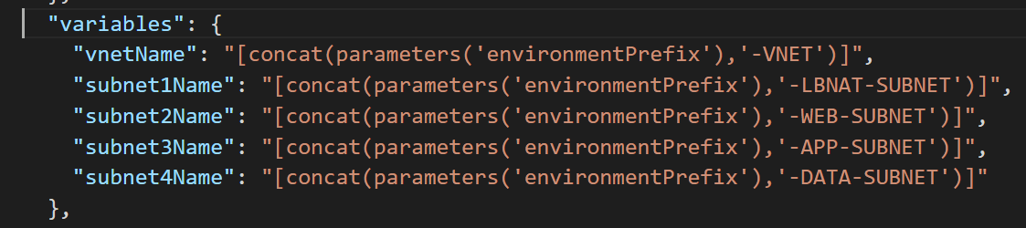
Snippet: concat() in action

Slide 55
ARM Advanced Feature: condition and equals()

Slide 56
Condition()…comparison functions
Allows you to compare two values with functions such as equals, less, lessOrEquals, greater, greaterOrEquals
Combine “equals” with the “condition” element to test whether a resource is deployed (most useful example of comparison functions that I’ve found yet)
{
“condition”: “[equals(variables(‘newOrExisting’),’new’]”
…
}
https://docs.microsoft.com/en-us/azure/azure-resource-manager/resource-group-template-functions-comparison

Slide 57
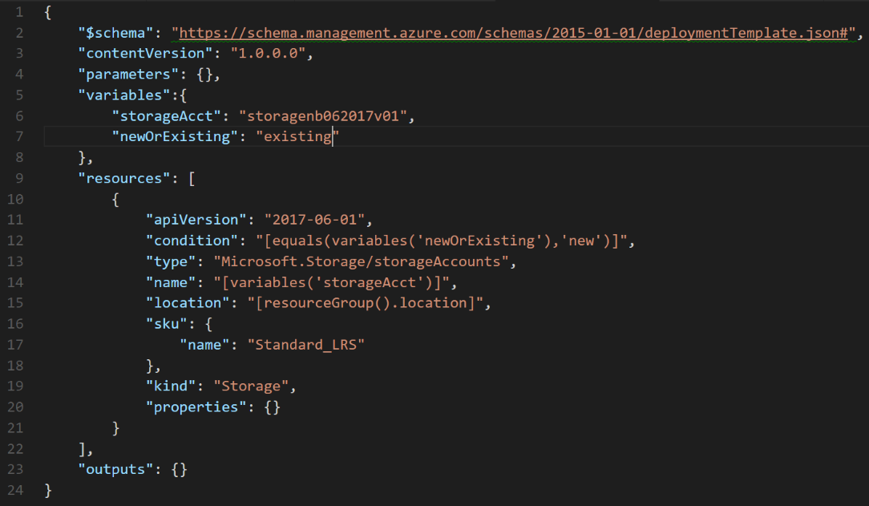

Slide 58
ARM Advanced Feature: copyIndex() aka Looping

Slide 59
copyIndex()…numeric function
Add a “copy” section to a resource and reference with the copyIndex() function
"resources": [
{
"apiVersion": "2016-01-01",
"type": "Microsoft.Storage/storageAccounts",
"name": "[concat(copyIndex(),'storage', uniqueString(resourceGroup().id))]",
"location": "[resourceGroup().location]",
"sku": {
"name": "Standard_LRS"
},
"kind": "Storage",
"properties": {},
"copy": {
"name": "storagecopy",
"count": 3
}
}
https://docs.microsoft.com/en-us/azure/azure-resource-manager/resource-group-create-multiple

Slide 60
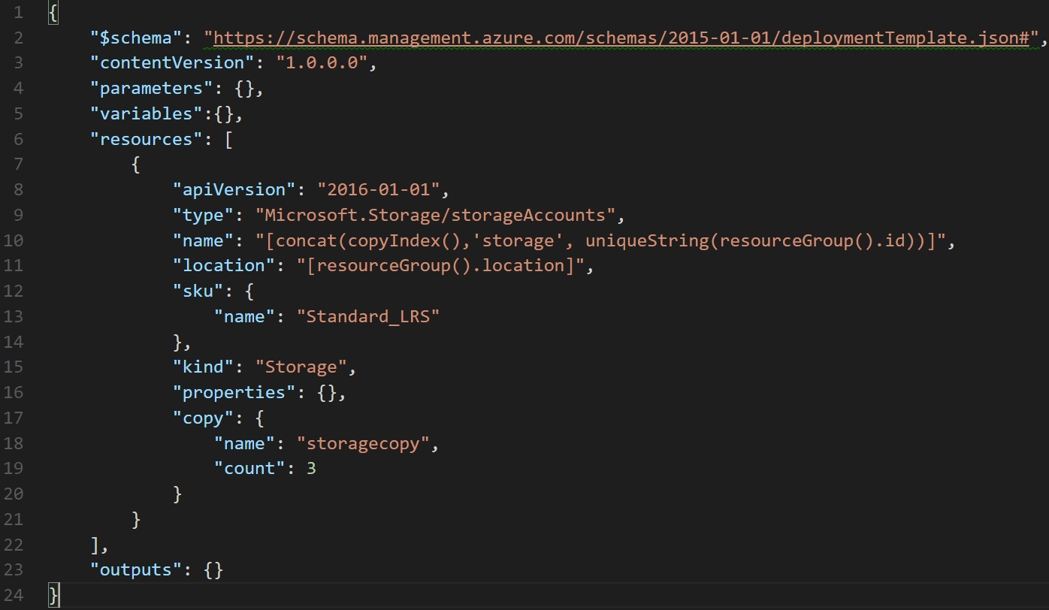

Slide 61
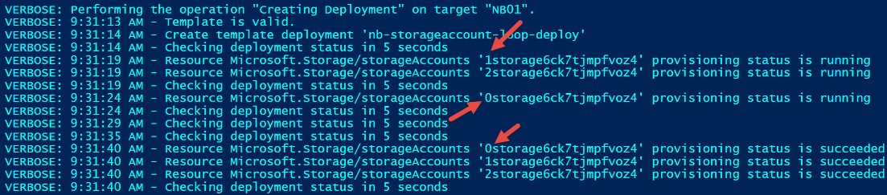
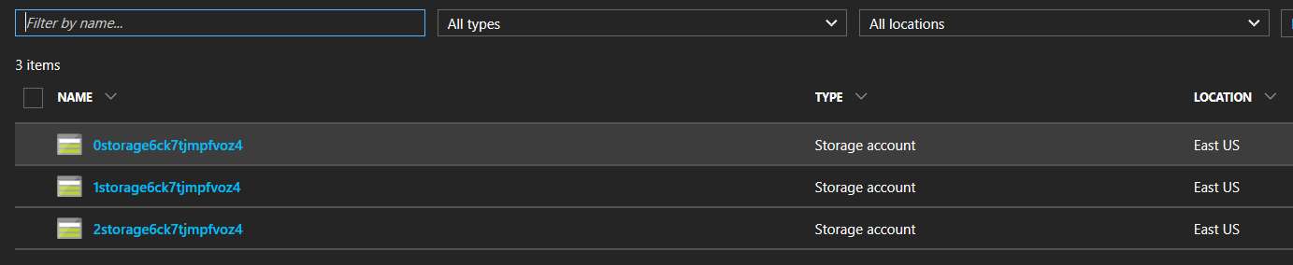
Verbose output

Slide 62
Can I create more meaningful names?
Tried:
"name": "[concat('storage-0', copyIndex(1))]", (did it work?)
Got error:
New-AzureRmResourceGroupDeployment : 9:51:45 AM - Error: Code=AccountNameInvalid; Message=storage-01 is not a valid storage account name. Storage account name must be between 3 and 24 characters in length and use numbers and lower-case letters only.
Tried:
"name": "[concat('storage0', copyIndex(1))]", (did it work?)
Got error:
New-AzureRmResourceGroupDeployment : 9:52:45 AM - Error: Code=StorageAccountAlreadyTaken; Message=The storage account named storage01 is already taken.

Slide 63
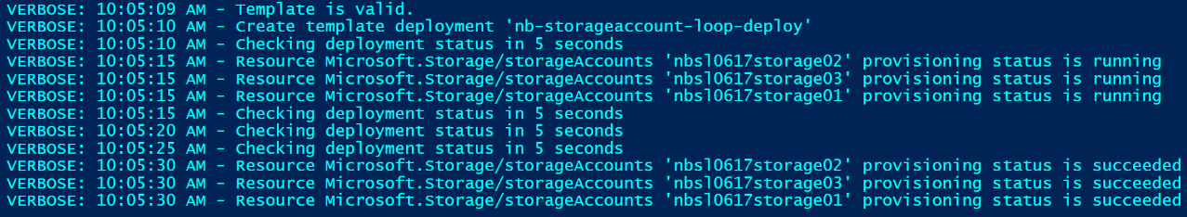
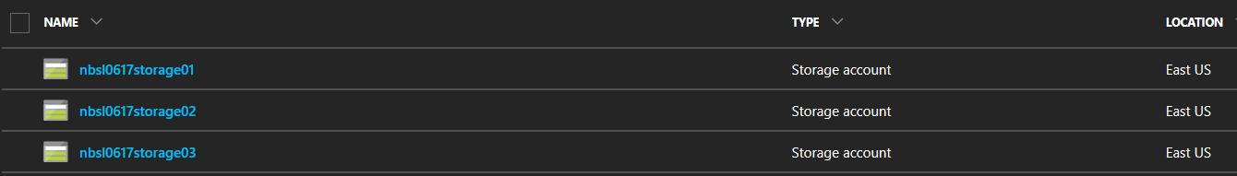
Got it working…finally
Tried:
"name": "[concat(parameters('environmentPrefix'),'storage0', copyIndex(1))]"

Slide 64
Final thoughts on looping with copyIndex()
You can iteratively create multiple resources of the same type
Resources are created in parallel unless the mode is set to “serial” (default is parallel…should it specified?)
You can iterate on a resource property also
Code snippets from documentation are difficult to get working. Never could get the Vnet and Subnet sample to work.
Comments on documentation page express clear frustration using copyIndex. Your mileage may vary.

Slide 65
ARM Advanced Feature: resourceId

Slide 66
resourceId()…resource function
Not the most useful bunch of functions (in my opinion)
resourceId() is seen often in auto generated templates and some from the Git repo
Returns the unique identifier of a resource which is useful when the resource name is ambiguous or not provisioned with the same template
Often used to reference storage accounts or virtual networks in an alternate resource group
"variables": {
"vnetID": "[resourceId(parameters('virtualNetworkResourceGroup'), 'Microsoft.Network/virtualNetworks', parameters('virtualNetworkName'))]",
"subnet1Ref": "[concat(variables('vnetID'),'/subnets/', parameters('subnet1Name'))]"
}
https://docs.microsoft.com/en-us/azure/azure-resource-manager/resource-group-template-functions-resource

Slide 67
ARM Advanced Feature: toLower()

Slide 68
toLower()…string function
Useful collection string manipulation functions
How useful depends on your needs and approach to ARM templates
toLower() useful to help ensure proper formatting
"variables":{
"prefix": "NBTL062017"
},
…
"name": "[concat('storagev', toLower(variables('prefix'))]",
https://docs.microsoft.com/en-us/azure/azure-resource-manager/resource-group-template-functions-string

Slide 69
Error without toLower()
Run nb-tolower-deploy.json with and without toLower (example error message without toLower below)
"error": {
"code": "AccountNameInvalid",
"message": "storev22NBTL062017 is not a valid storage account name. Storage account name must be between 3 and 24 characters in length and use numbers and lower-case letters only."
}

Slide 70
Advanced Functions: Food for thought
Some functions are easy to integrate into your templates (concat)
Some functions require some trial-and-error to get them to do what you expect (copyIndex)
Obviously some functions are more useful than others and some are simply not worth the effort
The real question is…how much intelligence do you want to insert into your templates?
It might make more sense to use Powershell or CLI as the “glue” that holds the template(s) together and contains the “real” intelligence
The bigger the template, the harder to maintain

Slide 71
Hands-on: Create an ARM Template with Advanced Features

Slide 72
Challenge #2 Deploy a simple network stack
Extend template to provision VNET w/one subnet
Template takes the following inputs:
Virtual Network Name and Address Prefix
Subnet Name and Address Prefix
Find an easier way to pass in parameters

Slide 73
Practices to avoid. . . ( !best practices )
Starting from scratch. . .
Leverage QuickStarts, Automation Script / Export, etc. to quickly get started
Over-parameterization (no defaultValues)
Use variables, functions/expressions, & intelligent defaults!
Duplicating code
Copy/Pasting and Nesting instead of using copy loops & functions/expressions
Variables for the sake of variables
“vmName” : “[parameters(‘vmName’)]”
Secrets in source
Use KeyVault and Managed Identity
Variables for api-version
New api-version represents an updated payload
Using the wrong template expression, wrong function or wrong approach (mul)
E.g. use resourceId() instead of concat()
Not using a template expression or wrong function
Unnecessary dependencies
Use dependsOn and/or reference() only when necessary
Hard-coding
URIs, Ips, secrets, locations, VM sizes, etc
RunOnce behaviors
Build idempotent, re-entrant templates
Thinking imperatively
ARM templates describe the goal state of an application, and the sequence in which that state can be realized
https://github.com/Azure/azure-quickstart-templates
Notes:
NSG – Secure the app
User Choice – when it makes sense (location, SKU)
Use reference for endpoints

Slide 74
ARM Best Practices (it’s personal)
Naming Conventions
Parameter Usage
Variable Usage
Outputs
One-ring-to-rule-them-all (single giant template) vs Nested (aka linked) templates
Reference Link: https://docs.microsoft.com/en-us/azure/azure-resource-manager/resource-manager-template-best-practices

Slide 75
Challenge #3 Deploy more than one resource
Extend template to open ports 80 and 22 on the default subnet
Hint: Consider variables, dependencies, and idempotency

Slide 76
Challenge #4 Let’s do something real…
Extend template to deploy a webserver VM
VM Requirements:
Linux VM
Apache website
Pull website config from: https://raw.githubusercontent.com/albertwo1978/training-events/master/p20-arm/scripts/install_apache.sh
Hint: Custom script extensions, globally unique naming context, and complex dependencies! ☺

Slide 77
Challenge #5 Prepare to scale!
Add a public load balancer and put webserver in the backend pool
VM Requirements:
Create frontend pool enabling port 80 to website
Notes:
If we’re talking to customers about devops in the cloud, then these are sure to be hot topics you will want to be familiar with.
Key to managing complexity with open source solutions is automation.
Chef, Puppet, Ansible, Terraform… these are all things that help you treat infrastructure as code and make it easy to automate repeatable set up of cloud environments.
You should at minimal be familiar with the purpose of these tools.
If you have time to learn, be able to do a quick demo in any of these is useful too.
Containers are quite buzzworthy these days.
It’s relatively easy to learn about Docker and use the command line to set up and deploy some containers with common apps in them.
Also make a great demo!

Slide 78
Challenge #6 Network access policies
Extend template to add NAT rule to ILB for SSH access to backend
Notes:
VS Code is a great tool to share with folks using open source tools.
It started as a lightweight code-editor that is cross-platform (Mac, Linux, and Windows)
It’s still a lightweight code-editor (compared to Visual Studio!)… but it’s got a lot of nice hooks into Azure, Github, and other dev tooling.
And if you’re editing files on your Linux VM… you can use ‘rmate’ to open files “remotely from the VM” for editing on your local PC!
It makes a great demo.
And it’s easier than using vim or emacs. (← oh yes… you should also get familiar with those too!)

Slide 79
Challenge #7 Now let’s scale it!
Extend template to replace VM with a VM Scale Set
VMSS Requirements:
Linux VM
Convert NAT rule to NAT pool
Notes:
VS Code is a great tool to share with folks using open source tools.
It started as a lightweight code-editor that is cross-platform (Mac, Linux, and Windows)
It’s still a lightweight code-editor (compared to Visual Studio!)… but it’s got a lot of nice hooks into Azure, Github, and other dev tooling.
And if you’re editing files on your Linux VM… you can use ‘rmate’ to open files “remotely from the VM” for editing on your local PC!
It makes a great demo.
And it’s easier than using vim or emacs. (← oh yes… you should also get familiar with those too!)

Slide 80
Challenge #8 Install some software on those VMs!
Extend template to add a custom script extension that installs a web server package/role and deploy a basic web app
VMSS Requirements:
Pull website config from: https://raw.githubusercontent.com/albertwo1978/training-events/master/p20-arm/scripts/install_apache_vmss.sh
Notes:
VS Code is a great tool to share with folks using open source tools.
It started as a lightweight code-editor that is cross-platform (Mac, Linux, and Windows)
It’s still a lightweight code-editor (compared to Visual Studio!)… but it’s got a lot of nice hooks into Azure, Github, and other dev tooling.
And if you’re editing files on your Linux VM… you can use ‘rmate’ to open files “remotely from the VM” for editing on your local PC!
It makes a great demo.
And it’s easier than using vim or emacs. (← oh yes… you should also get familiar with those too!)

Slide 81
Challenge #9 Let’s scale it automatically
Extend template to include auto scaling policy to scale when CPU performance hits 90%
VMSS Requirements:
Scale back down when CPU hits 30%
Scale in single VM increments
Enforce a 1 minute cool down between scale events
Notes:
VS Code is a great tool to share with folks using open source tools.
It started as a lightweight code-editor that is cross-platform (Mac, Linux, and Windows)
It’s still a lightweight code-editor (compared to Visual Studio!)… but it’s got a lot of nice hooks into Azure, Github, and other dev tooling.
And if you’re editing files on your Linux VM… you can use ‘rmate’ to open files “remotely from the VM” for editing on your local PC!
It makes a great demo.
And it’s easier than using vim or emacs. (← oh yes… you should also get familiar with those too!)

Slide 82
Challenge #10 Break it down into smaller parts
Separate deployments into nested templates
Minimum Requirements:
Separate virtual network and VMSS into two linked templates
Hint: Use blob storage + SAS token to load linked templates ☺
Notes:
VS Code is a great tool to share with folks using open source tools.
It started as a lightweight code-editor that is cross-platform (Mac, Linux, and Windows)
It’s still a lightweight code-editor (compared to Visual Studio!)… but it’s got a lot of nice hooks into Azure, Github, and other dev tooling.
And if you’re editing files on your Linux VM… you can use ‘rmate’ to open files “remotely from the VM” for editing on your local PC!
It makes a great demo.
And it’s easier than using vim or emacs. (← oh yes… you should also get familiar with those too!)

Slide 83
Challenge #11: (Day 3):
Bonus:
Deploy Jenkins and/or VSTS for CI/CD
Piece together previously created content into pipeline
Parameterize VM names in Jenkins

Slide 84
Stand Up

Slide 85
Wrap Up!

Slide 86



P20 Virtual Hackathon #3!
WRAP UP!
Notes:
Bem vinda! Bienvenidos!
Welcome to the OCP P20 Level UP! event
Olá! Meu nome é Peter Laudati
Eu sou djee Nova Jersey
Y por mis amigos de los otros paises,
Me llamo Peter. Soy de Neuva Jersey, y yo vivo circa de Neuva York.

Slide 87
IaC - Automation
L400+
Capability Level
L300
Infra & Mgmt
L200
Modern Workplace
Business Apps
Apps & Infrastructure
Data & AI
Technology & Solution Area

Slide 88
You got your hands dirty

Slide 89
*results are varied
Notes:
You might not grow a garden like this… but at least you can learn while trying.

Slide 90
P20 Virtual Hackathon #3!
Infrastructure as Code
THANK YOU!!!
Ali Hussain
Peter Laudati
SME – IaC
SME – Cat Herder
Albert Wolchesky
SME – Linux OS
Notes:
Bem vinda! Bienvenidos!
Welcome to the OCP P20 Level UP! event
Olá! Meu nome é Peter Laudati
Eu sou djee Nova Jersey
Y por mis amigos de los otros paises,
Me llamo Peter. Soy de Neuva Jersey, y yo vivo circa de Neuva York.

Slide 91
Thank you!!!

Slide 92
Next P20 Events
Azure IaaS Automation – Virtual - March 20th-22nd
Data & AI – Austin, Tx - April 17-19th
Modern Workplace – Austin, Tx – April 17-19th
Blockchain – Virtual – Dates TBD
Serverless + Bots – Virtual – Dates TBD
Business Apps – Virtual –Dates TBD

Slide 93


